Slide 1
Subject to follow
Dear colleagues,
How are you? I think you are well & good. I would like to request you to read the notes in normal mood carefully below the ‘Click to add notes’ option to conduct the class spontaneously. If you think any change to take the class more effectively, you can do that. In case of any inquiry please call 01556652300.
Your near and dear
Md. Hasan Hafizur Rahman
Content developer (English)
Cambrian School & College
Dhaka.
Notes:
Teacher may read the instructions carefully before going to the class.

Slide 2
Welcome to the world of
HHR PPT Presentation.
Notes:
Welcome slide. Teacher may change it .

Slide 3
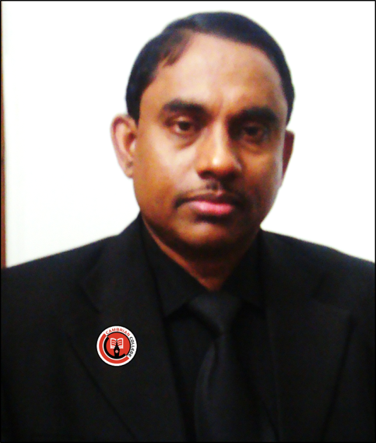
Introduction of the teacher & class
Md. Hasan Hafizur Rahman
Lecturer (English)
Cambrian School & College
Dhaka
English for Today
Class-IX-X
Notes:
Introduction of teacher & Class.

Slide 4
Learning outcomes
After studied this lesson, we will be able to –
ask and answer questions
read and understand the text through silent reading
describe and tell stories
Notes:
Speaking, listening and reading skills of English will be focused.

Slide 5
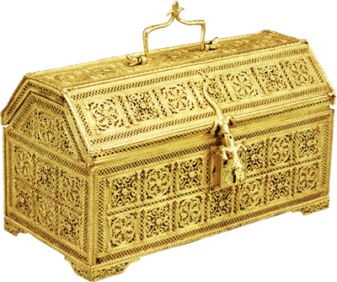
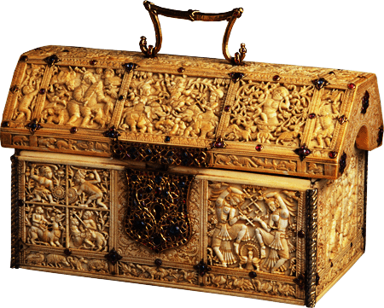
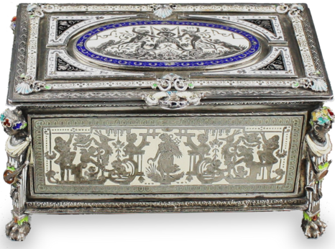
How many caskets have you seen?
Three Caskets.
Lead Casket
Gold Casket
Silver Casket
Notes:
Leading to the lesson declaration.

Slide 6
Our today’s lesson is-
Three Caskets
Unit - 14
Lesson-10
Notes:
Lesson declarartion

Slide 7
From the continuation of unit-14, lesson-9
Casket made of lead
Casket made of gold
Casket made of silver
Portia’s father wanted a man to marry Portia for herself and not for her wealth. He had three caskets made, one of gold, one of silver and one of lead. One of the caskets had Portia’s portrait in it. The suitor, who would first choose the casket with the portrait would marry her.
Notes:
Starting from the text topics.

Slide 8
He thought that silver and lead are poor metals. It is the casket made of precious metal that can hold the precious picture. So he chose the gold casket. But all he found was a picture of a skull with a message that said,
“All that glitters is not gold.”
The prince was very sad and went back home.
The first one to try was
the prince of Morocco.
Notes:
Idea of Morocco prince described.

Slide 9
He looked at the silver casket for a long time. On it was written, “He who chooses me will get what he deserves.” The prince had a very high opinion about himself. He thought that he deserved the best. He therefore chose the silver casket and opened it. Inside the casket he found the picture of a blinking fool. He was very disappointed and offended. He immediately rode away.
The second one was the prince of Spain
Notes:
Thinking of Spain prince described here.

Slide 10
He looked at the caskets for a long time. He thought, “ Appearances are often misleading. Bad men appear good and they hide their inner ugliness under fine clothes.” So he chose the plain looking lead casket. On opening the casket, he found the portrait of Portia inside.
The third and last one was Bassanio.
Notes:
Both the above ideas were propved false to Bassanio. He thought the best.

Slide 11
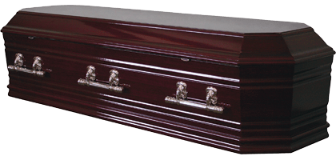
Let us know some new words to have clear idea about the topics.
Caskets
Ornament box,
Chests, treasuries
We use caskets to save our ornaments.
Notes:
If you want to show this option, just go according to the animation.

Slide 12
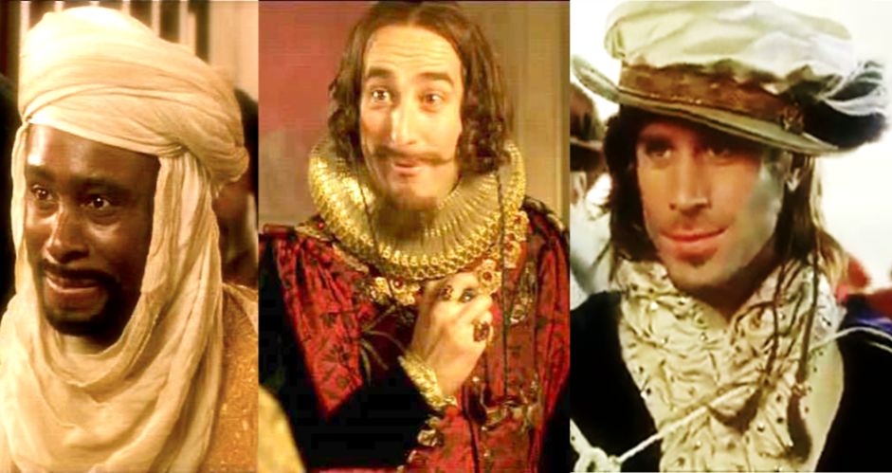
Suitor
A man with a view to wed a particular woman, lover, admirer
Three suitors came to wed Portia.
Notes:
Showing the word teacher may ask the meaning to the students, then he may show the picture, then meaning and sentence at last.

Slide 13
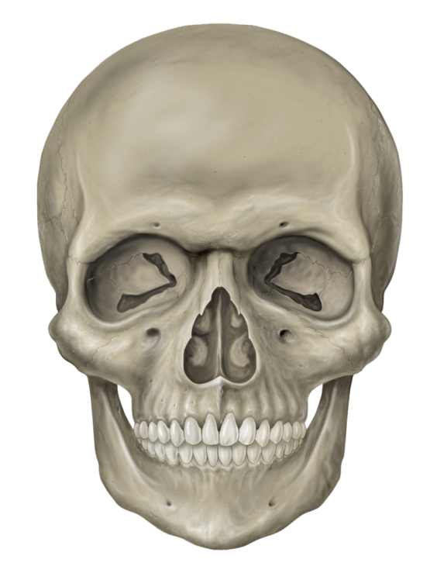
Skull
Bare head
The price of Morocco found a human skull in the gold casket.
Notes:
Showing the word teacher may ask the meaning to the students, then he may show the picture, then meaning and sentence at last.

Slide 14
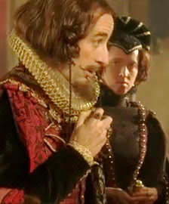
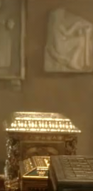
Deserve
Earn,
be worthy of
He thought that he would deserve the best.
Notes:
Showing the word teacher may ask the meaning to the students, then he may show the picture, then meaning and sentence at last.

Slide 15
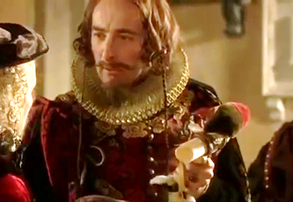
Blinking fool
Alternating, shape of a fool
The prince of Spain got a head of a blinking fool in the silver casket.
Notes:
Showing the word teacher may ask the meaning to the students, then he may show the picture, then meaning and sentence at last.

Slide 16
Disappointed
Upset, frustrated
The man in the picture looks disappointed.
Notes:
Showing the word teacher may ask the meaning to the students, then he may show the picture, then meaning and sentence at last.

Slide 17
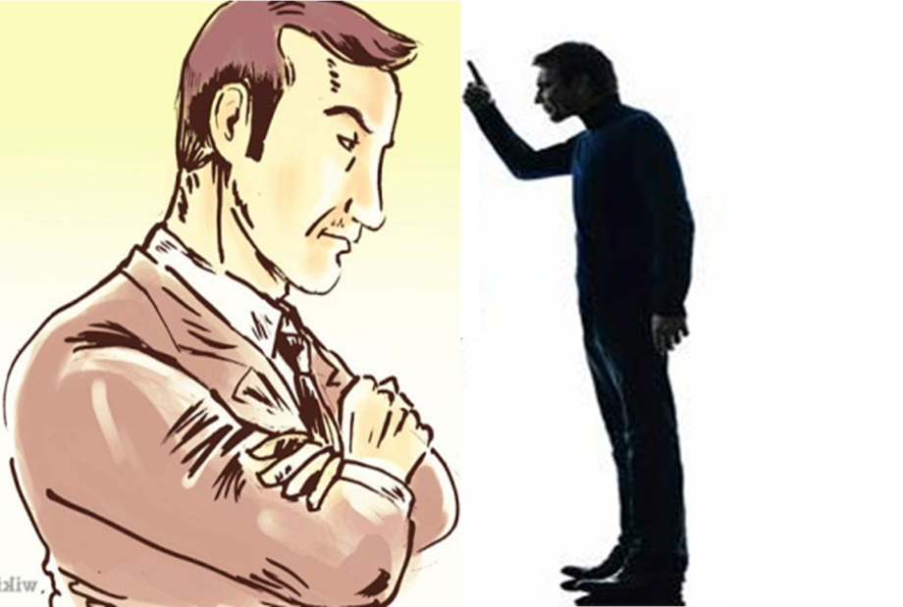
Offended
Insulted, hurt
If you offend others, you will be offended.
Notes:
Showing the word teacher may ask the meaning to the students, then he may show the picture, then meaning and sentence at last.

Slide 18
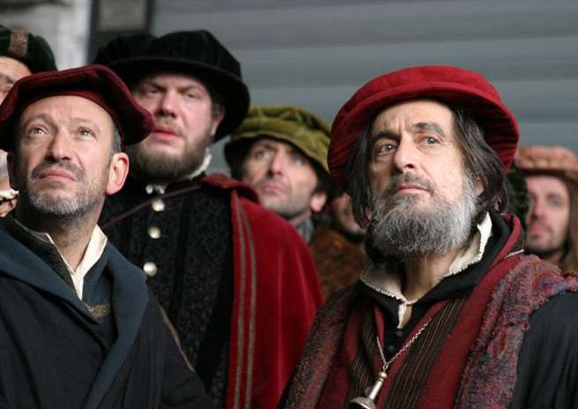
Appear
Seem, look
Evil men appear good but act ugly.
Notes:
Showing the word teacher may ask the meaning to the students, then he may show the picture, then meaning and sentence at last.

Slide 19
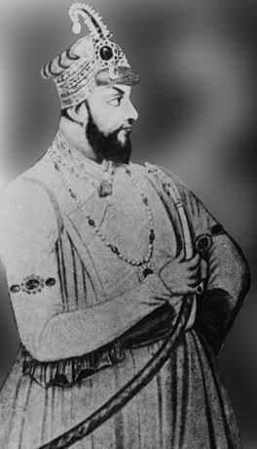
Ugliness
Evil, hostility, malice
Mir Jafar
Robert Clive
Bad people hide their ugliness under fine cloths.
Notes:
Showing the word teacher may ask the meaning to the students, then he may show the picture, then meaning and sentence at last.

Slide 20
Messenger
One who send massage, pion, envoy, runner
The man who send massage to other is a messenger.
Notes:
Showing the word teacher may ask the meaning to the students, then he may show the picture, then meaning and sentence at last.

Slide 21
Dear colleagues,
Please conduct this session manually with text books, board, marker and other elements you need.

Slide 22
B Read the text and answer the following questions.
Bassanio went to Belmont to visit Portia grandly dressed, with many servants. Portia’s father had died lately. Before his death he had thought of an unusual plan to find a good husband for his daughter. He wanted a man to marry Portia for herself and not for her wealth. He had three caskets made, one of gold, one of silver and one of lead. One of the caskets had Portia’s portrait in it. The suitor, who would first choose the casket with the portrait would marry her. Many suitors went away when they heard about such a strange condition. The first one to try was the prince of Morocco. He thought that silver and lead are poor metals. It is the casket made of precious metal that can hold the precious picture. So he chose the gold casket. But all he found was a picture of a skull with a message that said, “All that glitters is not gold.” The prince was very sad and went back home.

Slide 23
Then came the prince of Spain. He looked at the silver casket for a long time. On it was written, “ He who chooses me will get what he deserves.” The prince had a very high opinion about himself. He thought that he deserved the best. He therefore chose the silver casket and penned it. Inside the casket he found the picture of a blinking fool. He was very disappointed and offended. He immediately rode away.
Then it was Bassanio’s turn. He looked at the caskets for a long time. He ought, “ Appearances are often misleading. Bad men appear good and they hide their inner ugliness under fine clothes.” So he chose the plain looking lead casket. On opening the casket, he found the portrait of Portia inside. Bassanio and Portia got married. There was great joy at Belmont and the newly married couple were spending their time happily. But soon their happiness turned into sorrow by a piece of news. A messenger came with a letter from Antonio. The letter said, “ Dear friend Bassanio, all my ships have been lost at sea. I cannot pay the money I owe to Shylock. So I have to pay the penalty. Dear friend, come and see me if possible. I would like to see you once before I die.” Bassanio quickly left for Venice.

Slide 24
Questions
1 Why did Portia’s father make such a strange plan?
2 Write what you know of the three caskets.
3 How many people attempted to choose the right casket? What was the result?
4 Who succeeded to marry Portia? Why/How?
5 Why did the joyous mood at Belmont turn into sadness?
Notes:
Evaluation by asking question to the students.

Slide 25
See you again in the third episode “ The Trial.”
Notes:
Ending slide.

